Slide 1
LEGAL AWARNESS SYSTEM
CREATED BY: SHREYASH TRIVEDI

Slide 2
Legal Literacy and Legal Awareness programme
The spirit and very purpose of providing free and competent legal services to the weaker and deprived sections of the society, as envisaged in Act, 1987, will be defeated in case the weaker section could not be made aware of their various legal and constitutional rights.
Illiteracy makes a person unable to recognize injustices done to him/her. When a person is ignorant of basic human rights, Social Welfare schemes fail to be effective as he/she is unable to avail of the opportunities provided by the Govt. for upliftment of his/her standard of living. As such, Legal Literacy is the effective tool to project human rights. It can help the people recognize their civil, political, social and cultural rights. Only when the people can be made aware of what the laws offer to them, they will be less susceptible to injustices confronting them.
As a measure to spread legal literacy amongst the people and in particular to educate the weaker sections of the society about the rights, benefits and privileges guaranteed by Social Welfare legislations and other enactments as well as administrative programmes and measures, 27 (twenty-seven) leaflets in Bengali and in Kokborok (i.e., local tribal language) on the subjects detailed below have been prepared, printed and are being distributed to the participants in different programmes and seminars organized by the Authorities/Committees.
01) Legal Aid Scheme and Suggestions; 02) Laws relating to Alternative Justice Delivery System;

Slide 3
03) Laws relating to Family Dispute, Counselling and Family Court
04) Constitutional Rights and Duties of the Citizen;
05) Laws relating to Rights of Women with specific reference to Human Rights Act, 1993; 06) Laws relating to National Women Commission Act, 1990;
07) Laws relating to Pre-natal Diagnostic Techniques (Prevention of Misuse) Act, 1994;
08) Laws relating to Immoral Trafic (Prevention) Act,1956;
09) Laws relating to Adoption & Maintenance Act; 1956;
10) Laws relating to Maternity Benefits Act, 1961; 11) Laws relating to Dowry Prohibition Act, 1961; 12) Laws relating to Maintenance;
13) Laws relating to Position of Women in Islamic Society; 14) Laws relating to Consumers Protection Act, 1986; 15) Laws relating to Physically Disabled People and different Schemes prescribed thereunder;
16) Laws relating to Hindu Marriage and Divorce;

Slide 4
17) Laws relating to Tripura Recording of Marriage Act, 2003;
18) Laws relating to Right to Information Act, 2005;
19) Social Welfare Schemes (Book No.1);
20) Social Welfare Schemes (Book No.2); 21) Laws relating to Juvenile Justice (Care and Protection of Children) Act, 2002; 22) Laws relating to NBFCs; 23) Laws relating to Plea Bargaining; 24) Laws relating to Maintenance and Welfare of Parents and Senior Citizens Act, 2007; 25) Laws relating to Mahatma Gandhi National Rural Employment Guarantee Act (MGNREGA), 2005; 26) Laws relating to Labour Laws; and 27) Laws relating to ‘Unorganised Workers’ Social Security Act, 2008.

Slide 5
ADVANTAGES
Fighting Injustice and Women — The main reason is that Legal education helps in changing the attitude of public and make them connect to the social problems; it makes people more aware about their rights and duties and help them to become ideal citizens.
Many enactments have been made for society’s greater good, such as
Dowry Prohibition Act,
Child Marriage Restraint Act,
Sati Prohibition Act, etc.

Slide 6
2. Empowerment — Free legal assistance to Women who are not able to enforce the rights given to them by law. They can be achieved by holding frequent legal advice camps at different places.
3. Understanding the scope of Human rights — Establishments of Legal Advice centers. Educating the rural masses the matters of their rights and responsibilities in a welfare society. Help of legal academicians, professors, advocates and other such professionals who can aid in the better understanding of laws and its working should be resorted. People must be informed about their political, civil, social, economic and cultural rights.

Slide 7
4. Increase in knowledge about law — Implementation of social mechanisms such as Legal seminars, camps, workshops etc, must be undertaken to make the people aware of the present legal structure.
Likewise, various steps have been initiated by the State Legal Services Authority for creating legal Awareness in their states:
Legal literacy camps/seminars
Mass awareness through Print Media
Creating awareness through EDUSAT
Awareness programmes for women
Training and Strengthening of legal aid department

Slide 8
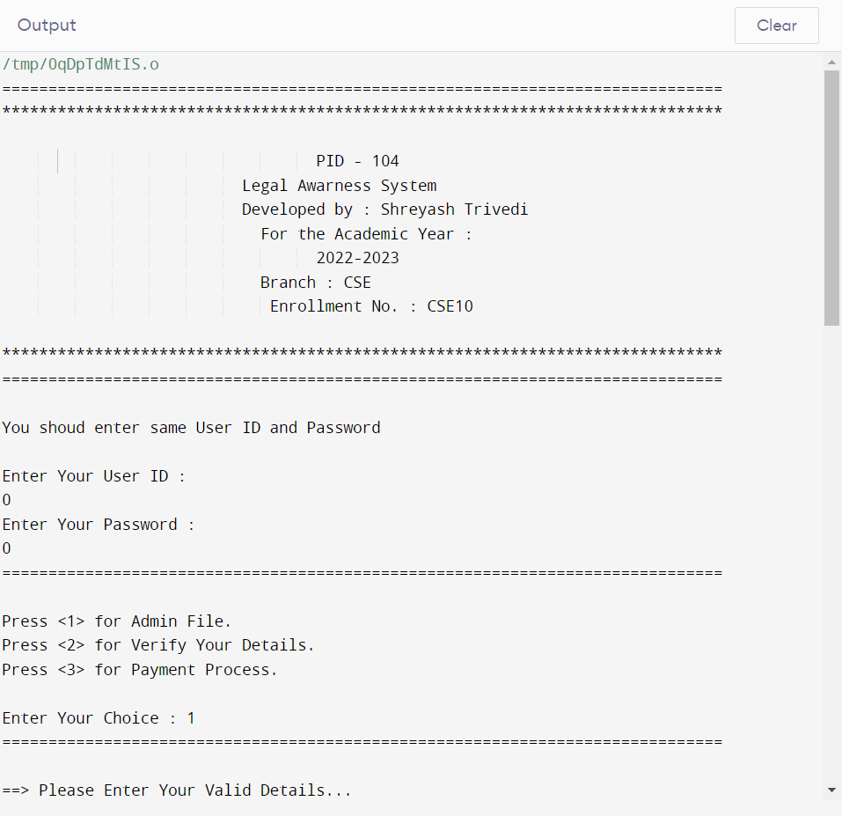
POJECT CODES AND RUNNING

Slide 9
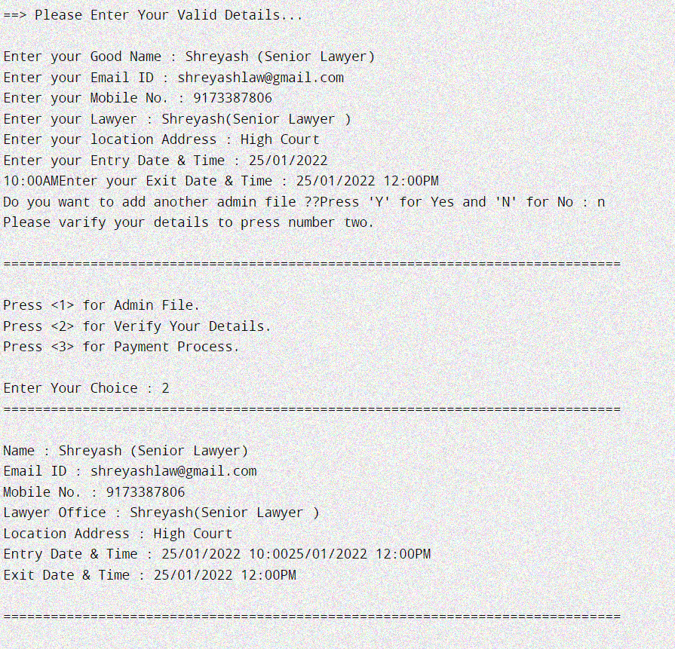

Slide 10
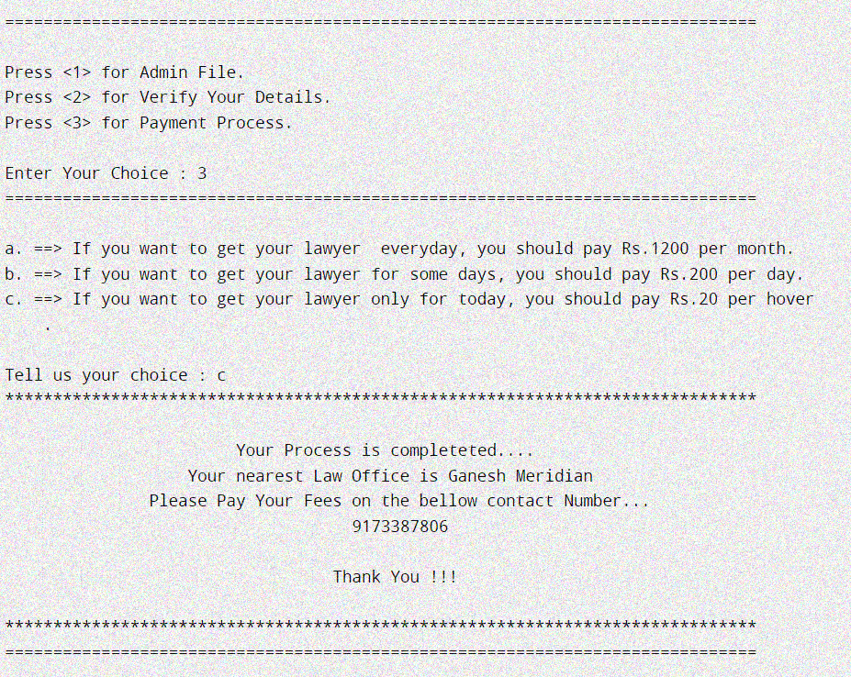

Slide 11
SUMMARY
Since 2012, A2J Division of Department of Justice (DoJ), Ministry of Law and Justice, Government of India has been implementing Access to Justice Scheme in North Eastern States including Arunachal Pradesh, Assam, Manipur, Meghalaya, Mizoram, Nagaland, Sikkim, Tripura and in UT of Jammu & Kashmir. Major focus of these programmes are on Legal Empowerment of community, dissemination of simplified Information, Education and Communication (IEC) materials in local languages and dialects and capacity development of Panchayati Raj Functionaries and Village Chiefs on formal justice delivery system. First phase of the A2J-NEJK Scheme got completed in 2017 and second phase of the Scheme completed in March 2021.

Slide 12
The Legal Literacy and Legal Awareness Programme aims to empower the poor and disadvantaged sections of society to seek and demand justice services. The Programme also seeks to improve the institutional capacities of key justice service providers to enable them to effectively serve the poor and disadvantaged.

Slide 13
THANK YOU TO VISITING MY PROJECT

